Slide 1
HelmNet
PGP-AIML-BA-UTA-Jun25-D
01/12/2026
Yashpal Singh

Slide 2
Contents / Agenda
Exeuative Summary
Data Overview
Exploratory Data Analysis
Data Pre-processing
Basic Convolutional Neural Network
VGG-16 Model
VGG-16 with FFNN
VGG-16 with Data Augmentation
Model Performance Comparison and Final Model Selection

Slide 3
Executive Summary: HelmNet Safety Compliance System
1. Project Overview :
SafeGuard Corp identified a critical safety gap in high-risk industrial environments where manual monitoring for safety helmet compliance is prone to human error, fatigue, and "blind spots". The HelmNet project was launched to develop an automated, real-time computer vision solution to ensure 100% compliance with Personal Protective Equipment (PPE) protocols, thereby mitigating the risk of workplace fatalities and long-term disabilities.
2. Business Problem and Objectives
Manual oversight often leads to a delayed response, identifying non-compliance only after an incident has occurred. Our technical objective was to architect a high-precision binary classifier—With Helmet (Class 1) vs. Without Helmet (Class 0)—that remains robust across diverse lighting, angles, and postural variations.
3. Data Insights & Strategy
The system was trained on a balanced dataset of 631 high-diversity images (311 With Helmet, 320 Without Helmet
Near-Perfect Class Balance: This symmetry (51% to 49%) prevented statistical bias toward a majority class, ensuring that our performance metrics—especially Accuracy and Recall—are highly reliable.
Preprocessing: We utilized Gray Scaling for computational efficiency and Standardization (scaling pixels to 0–1) for faster convergence

Slide 4
Executive Summary: HelmNet Safety Compliance System
4. Model Evolution & Final Selection:
A four-stage experimental roadmap is conducted:
Base CNN: Established a strong baseline but lacked the depth for complex features.
VGG-16 (Base): Showed signs of underfitting due to a lack of complexity in its classification head.
VGG-16 + Data Augmentation: Highly accurate on training data (0.978) but showed slight "memorization" behavior.
Final Choice—VGG-16 with FFNN (Feed-Forward Neural Network): This architecture emerged as the "Winner". It achieved the best balance of safety and reliability, capturing complex spatial relationships with exceptional generalization.
5. Performance Results:
The selected VGG-16 + FFNN model demonstrated flawless reliability on unseen data:
Validation Accuracy/Recall/F1: 0.9841.
Test Results: Achieved a perfect score of 1.0 across all key metrics (Accuracy, Precision, Recall, and F1-Score) on the final test set.
Safety-First Reliability: The model eliminated both False Positives and False Negatives, demonstrating it has reached maximum discriminative capacity for this environment

Slide 5
Executive Summary: HelmNet Safety Compliance System
6. Actionable Insights & Recommendations
Deploy VGG-16 + FFNN: The model is ready for integration into SafeGuard Corp’s monitoring infrastructure due to its perfect generalization and zero "False Negative" rate during testing.
Prioritize Recall for Compliance: In future iterations, continue to weight Recall as the primary safety metric to ensure no un-helmeted worker goes undetected.
Scalability: The model’s success with "action-oriented" images confirms it can be scaled to monitor workers in motion, not just in static poses.
Continuous Improvement: While the current model is perfect for this dataset, we recommend ongoing data collection of edge cases (e.g., extremely low light or obscured views) to maintain this high performance in evolving site conditions.

Slide 6
Business Problem - HelmNet
Business Context :
Workplace safety in hazardous environments like construction sites and industrial plants is crucial to prevent accidents and injuries. One of the most important safety measures is ensuring workers wear safety helmets, which protect against head injuries from falling objects and machinery. Non-compliance with helmet regulations increases the risk of serious injuries or fatalities, making effective monitoring essential, especially in large-scale operations where manual oversight is prone to errors and inefficiency.
Problem Statement :
The challenge of scalable safety compliance
In high-risk industrial and construction environments, head injuries remain a leading cause of workplace fatalities and long-term disability. While safety helmets are a mandatory defense, manual monitoring of compliance in large-scale operations is fundamentally flawed due to:
Human Oversight Limitations: Safety officers cannot monitor every zone simultaneously, leading to "blind spots" in enforcement.
Operational Inefficiency: Manual checks are labor-intensive and prone to fatigue-driven errors.
Delayed Response: Non-compliance is often identified only after an incident occurs, rather than through proactive prevention.
There is a critical need for an automated, computer-vision-based auditing solution that provides consistent, real-time oversight to mitigate these risks and ensure a zero-harm work culture.

Slide 7
Business Problem - HelmNet
Project Objective :
Development of an Automated Vision System for Safety Enforcement
The primary goal of this project is to architect and train a high-precision Deep Learning Image classification model capable of distinguishing between compliant and non-compliant safety practices through image analysis.
Key Technical Milestones :
Robust Classification: Develop a Binary Classifier to accurately categorize images into With Helmet and Without Helmet across diverse environmental conditions (varying lighting, angles, and distances).
Evaluation Excellence: Achieve high Recall scores to minimize "False Negatives" (failing to detect a worker without a helmet), as these represent the highest risk to the organization supported by the F1 Score

Slide 8
Solution Approach
Data Strategy & Exploratory Analysis (EDA) : Building a Foundation of Data Integrity.
Quality Audit: Analyzing dataset uniqueness to prevent data leakage and checking for class imbalance
2. Data Preprocessing :
Normalization: Scaling pixel values to 0, 1 for faster gradient convergence.
Dimensionality: Standardizing image resolution for model input.
Gray Scaling Analysis: Evaluating if color is a critical feature (e.g., high-visibility yellow/orange) or if geometric features (the shape of the helmet) are sufficient.
3. Split Strategy: Using an 80/10/10 (Train/Val/Test) split to ensure the final evaluation is performed on completely unseen data
4. The Modeling Evolution (Architectural Roadmap) : From Baseline to transfer learning
Four-stage experimental design to identify the most robust architecture
Baseline (Simple CNN): A custom-built shallow network to establish a performance floor.
Transfer Learning (VGG-16 Base): Leveraging spatial hierarchies learned from ~1.4 million images (ImageNet).
Enhanced VGG-16 (+FFNN): Replacing the standard head with a custom Feed-Forward Neural Network to capture complex relationships in safety gear features.
Regularized VGG-16 (+Data Augmentation): Stress-testing the model by simulating environmental variances (rotations, zoom, and shifts) to ensure Translational Invariance.

Slide 9
Solution Approach
5. Results & Decision Logic: Validation Performance & Model Selection.
Evaluation Excellence: Compare above trained model and achieve high ,Accuracy(general reliability) ,Recall scores to minimize "False Negatives" (failing to detect a worker without a helmet), as these represent the highest risk to the organization followed by the F1 Score and get finalized the best model
Why these metrics matter most and aligned with project objective
The Priority : Recall(Sensitivity)
In a safety context, Recall is the most critical metric. Recall answers the question: "Of all the workers actually not wearing a helmet, how many did the system correctly flag?“
The Goal: Minimize False Negatives (workers without helmets who are marked as "safe" or missed by the system).
The Stakes: A False Negative means a worker enters a hazardous zone unprotected, which could lead to a fatality. This is a catastrophic failure for SafeGuard Corp.
The Trade-off: You would rather have the system "over-alert" (flagging someone with a bulky hat as a violation) than "under-alert" (missing a person with no protection).
2. The Balancer : F1 Score
While Recall prevents accidents, Precision can not be ignored entirely. If model has 100% Recall but 5% Precision, it will trigger false alarms every 30 seconds, leading to "alarm fatigue" where supervisors eventually ignore the system.
The Role of F1: The F1-Score is the harmonic mean of Precision and Recall.
Why it's better than Accuracy: Accuracy is misleading if dataset is imbalanced (e.g., if 95% of workers already wear helmets, a broken model that just guesses "Helmet" every time would still be 95% accurate but 0% effective at finding violators).

Slide 10
Solution Approach
Success Metrics
Metric | Business Impact | Risk of ignoring
Accuracy | General overview of performance | High. Fails to account for class imbalance (fewer violators than safe workers).
Recall(Sensitivity) | Saves lives. Ensures every violator is caught. | Critical. Low recall leads to workplace fatalities.
Precision | Reduces false alarms for the safety team. | Moderate. High precision is "clean" but might miss actual risks.
F1 Score | Balances safety and efficiency | High, robustness of the model
6. Final Inference:
Executing predictions on the test data utilizing the best-performing model to ensure robust classification in diverse industrial environments

Slide 11
Data Overview
There are two Categories of the Datasets :
1. The Image dataset consists of 631 images
Two categories Images :
With Helmet: 311 images
Without Helmet: 320 images
Shape : (631,200,200 ,3)
2. Label Data set having two categories
0→Without Helmet (320)
1→ With Helmet (311)
Shape: (631, 1)

Slide 12
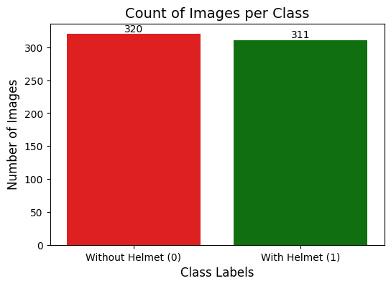
Exploratory Data Analysis
Checking for Class Imbalance:
High Data Symmetry and Balance : The dataset exhibits balance between the two target classes, with 320 samples for "Without Helmet" (0) and 311 samples for "With Helmet" (1). This near-perfect ratio (approx. 51% to 49%) ensures that the model will not develop a statistical bias toward a majority class,
Elimination of Accuracy Paradox Risks: Because the classes are balanced, Accuracy remains a reliable and meaningful metric as well for this
Reliability of the Recall Metric: The plot shows that the "Without Helmet" class is slightly better represented (320 images). This is strategically advantageous because given objective prioritizes Recall for the non-compliant class.

Slide 13
Data Pre-processing
1. Gray Scaling : The OpenCV library (cv2.cvtColor() is used to convert the image to grayscale which is - beneficial to reduces computational requirements.
2. Dataset Splitting :
train_test_split() function from scikit-learn is used to split the dataset into three parts, train, test and validation.
Using an 80/10/10 (Train/Val/Test) split to ensure the final evaluation is performed on completely unseen data
Train Image Dataset : (504, 200, 200, 3) Train Label Dataset (504, 1)
Validation Image Dataset : (63, 200, 200, 3) Validation Label Datasets (63, 1)
Test Image Dataset : 64, 200, 200, 3) Test Label Dataset (64, 1)
3. Data Normalization : As the image pixel values range from 0-255 , hence scaling as method of normalization is used and for it and all the pixel values are divided by 255 to standardize the images to have values between 0-1.

Slide 14
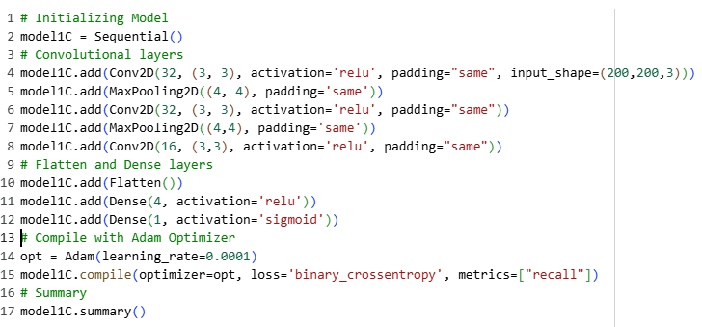
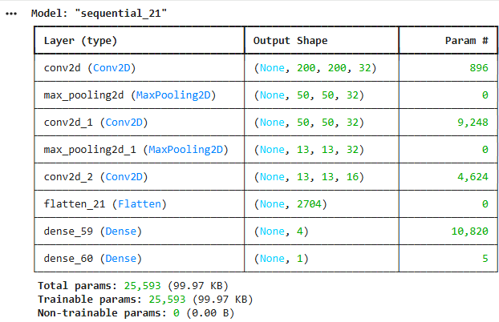
Basic Convolutional Neural Network- MODEL1C
Model Configurations
Model Summary
Batch Size=128
Epochs=11
Note : I have tried various combination of the configurations for Model1 as model1A , Model1B and Model1C and found Model1C is the best model based on the generalization and the simplicity for basic CNN and others were overfitting

Slide 15
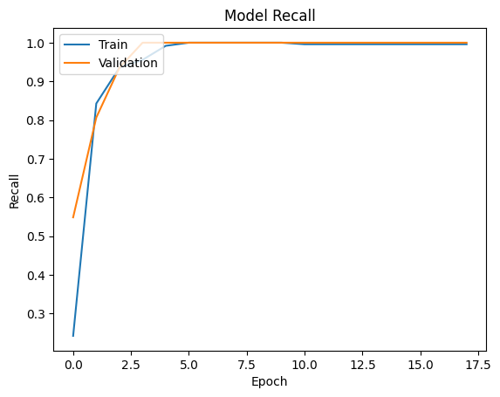
Basic Convolutional Neural Network- MODEL1C
Performance Metrics
Type of Dataset | Accuracy | Recall | Precision | F1 Score
Training | 0.938492 | 0.938492 | 0.942935 | 0.938389
Validation | 0.952381 | 0.952381 | 0.956583 | 0.952309
Observations :
Exceptional Convergence & Stability: The Recall plot shows an incredibly strong performance. Both the Training Recall and Validation Recall curves rise sharply and plateau at approximately 1.0 (100%) very early in the training process (within the first few epochs)
Rapid Learning : The model is "hitting the mark" almost immediately, which suggests that the features in your dataset are very distinct and the CNN architecture is highly capable of capturing them
Generalization: Since the Validation line is closely hugging the Training line (and in some segments even slightly exceeding it), the model is generalizing perfectly to unseen data.

Slide 16
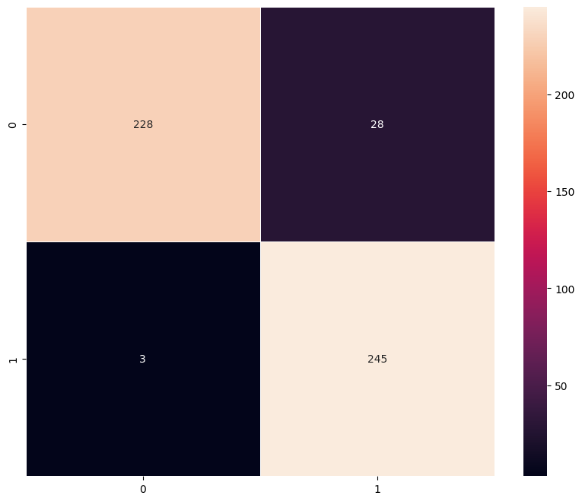
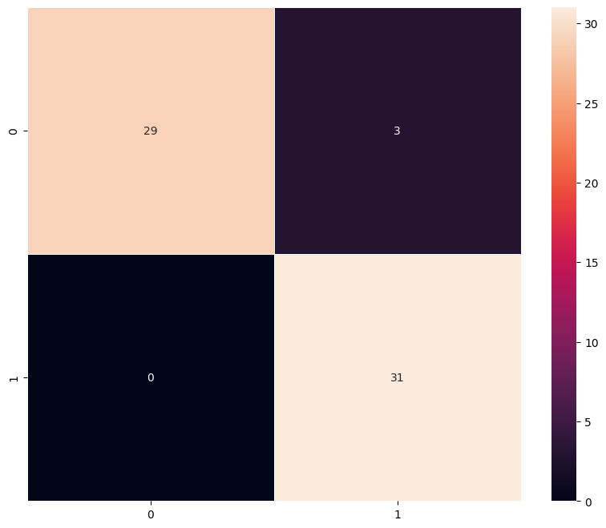
Basic Convolutional Neural Network- MODEL1C
Training Dataset
Validation Dataset
Training Dataset Analysis
High Sensitivity: The model correctly identified nearly all positive cases, with only 3 false negatives out of 248 actual "1" instances.
Minor Overfitting Indicator: There are 28 false positives (actual "0" predicted as "1"), suggesting the model is slightly more aggressive in predicting the positive class during training.
Validation Dataset Analysis
Perfect Recall: The model achieved 0 false negatives, meaning it successfully captured every single actual "1" case in the validation set.
Excellent Generalization: With an overall accuracy of approximately 95% (60/63 samples correctly classified), the model performs consistently well on unseen data compared to the training set.

Slide 17
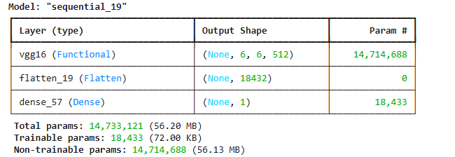
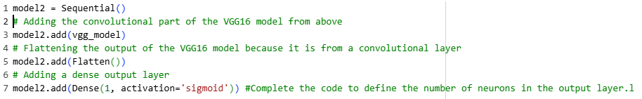
VGG-16 Model- Model model2
Model Summary
Model Configurations
Epoch=6
Batch Size=128

Slide 18
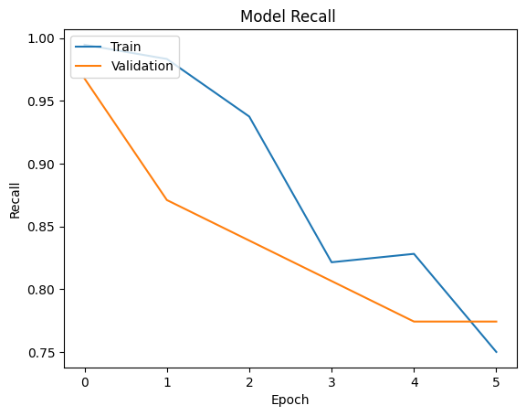
VGG-16 Model- Model Model 2
Model Performance Metrics
Type of Dataset | Accuracy | Recall | Precision | F1 Score
Training | 0.914683 | 0.914683 | 0.926952 | 0.913938
Validation | 0.888889 | 0.888889 | 0.908832 | 0.887295
Observations:
Recall Stability and Convergence: The recall plot displays significant fluctuations and a widening gap between training and validation, indicating the model is struggling to generalize and is currently overfitting to the training distribution.
Metric Balance and Error Analysis: While the model achieves high training accuracy, the inconsistent validation recall suggests that the VGG-16's deep architecture is "memorizing" specific features rather than learning robust, class-agnostic representations.
Optimization and Gradient Behavior: The erratic spikes in the validation curve point to an unstable learning rate; the model would benefit from a decay schedule to smooth out convergence and minimize the variance in its sensitivity.
Architecture-Specific Generalization: The disparity in performance metrics suggests that the fully connected layers are over-parameterized for this dataset, necessitating stronger regularization like Dropout to stabilize the recall.

Slide 19
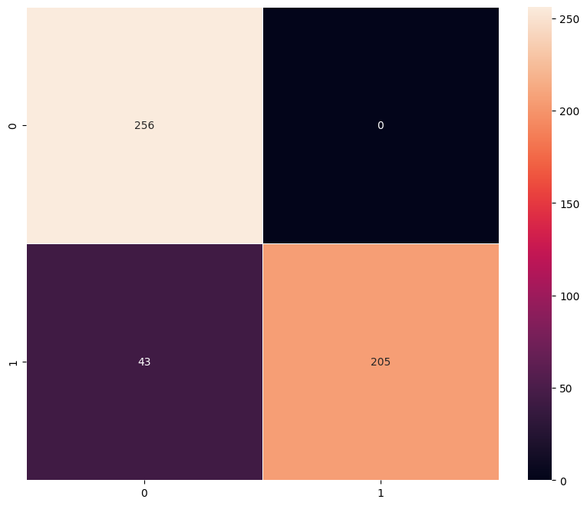
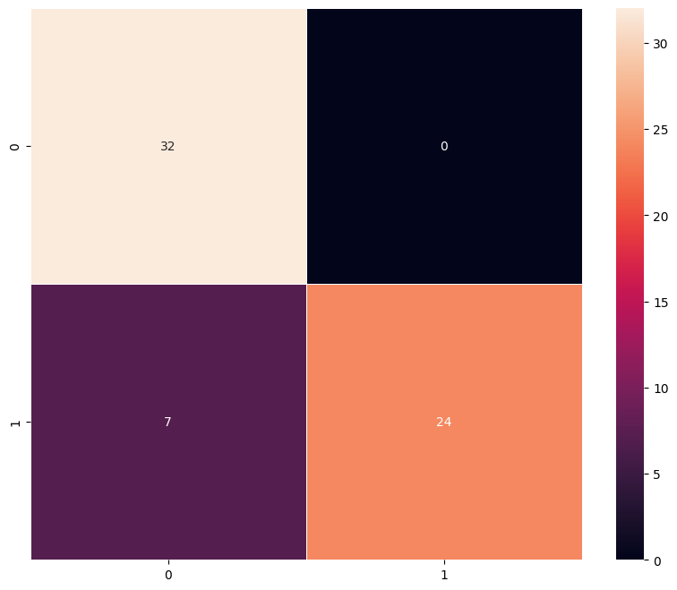
VGG-16 Model- Model Model2 Confusion Metrics
Training Data
Observations
Training Class Separation: The training confusion matrix shows perfect identification for Class 0 (256 correct, 0 missed), but significant leakage in Class 1 where 43 instances were misclassified as Class 0.
Validation Generalization: Similar to training, the validation set achieves 100% accuracy on Class 0 but struggles with Class 1, failing to identify 7 out of 31 total instances (approx. 22.6% error for that class).
Asymmetric Error Profile: The model exhibits a strong "False Negative" bias for Class 1 across both datasets, suggesting the decision boundary is heavily weighted toward the features defining Class 0.
Over Learned : The zero misclassifications for Class 0 compared to the repeated errors in Class 1 indicates the model has likely over-learned the majority class and requires better class-weight balancing.
Validation Data

Slide 20
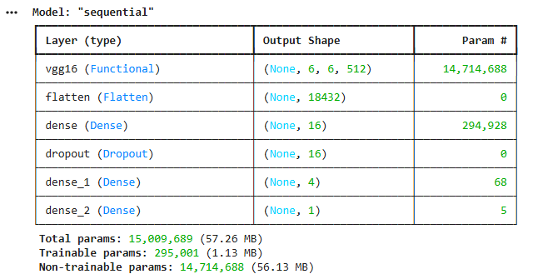
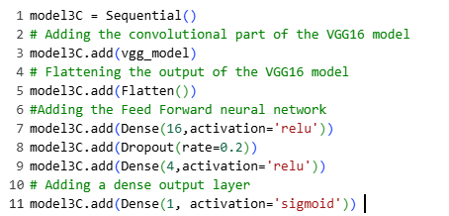
VGG-16 with FFNN-Model model3C
Model 3C-Summary
Model 3 Configurations
Epoch=6
Batch Size=128

Slide 21
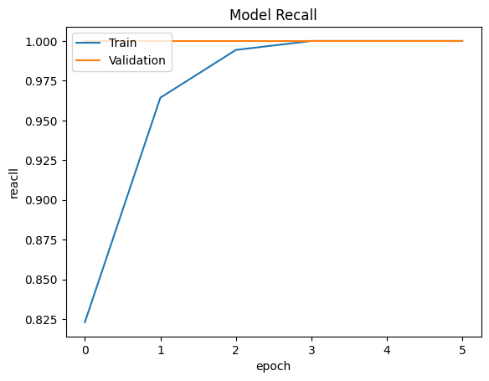
VGG-16 with FFNN-Model model3C
Model Performance Metrics
Observations :
Exceptional Recall Convergence: The model achieves near-perfect recall on both training and validation sets by epoch 3, demonstrating highly efficient feature extraction and class sensitivity.
Superior Generalization Power: With a validation accuracy of 98.41% slightly outperforming the training accuracy of 96.23%, the model shows excellent stability and no signs of overfitting.
High-Precision Feature Alignment: The precision and F1 scores are closely aligned above 98% in validation, confirming that the FFNN integration effectively minimizes false positives compared to standard VGG-16 blocks.
Rapid Learning Dynamics: The steep upward trajectory of the training recall curve suggests that the FFNN layers are quickly optimizing the decision boundary for this specific dataset distribution.
Type of Dataset | Accuracy | Recall | Precision | F1 Score
Training | 0.962302 | 0.962302 | 0.964984 | 0.962271
Validation | 0.984127 | 0.984127 | 0.984623 | 0.984127

Slide 22
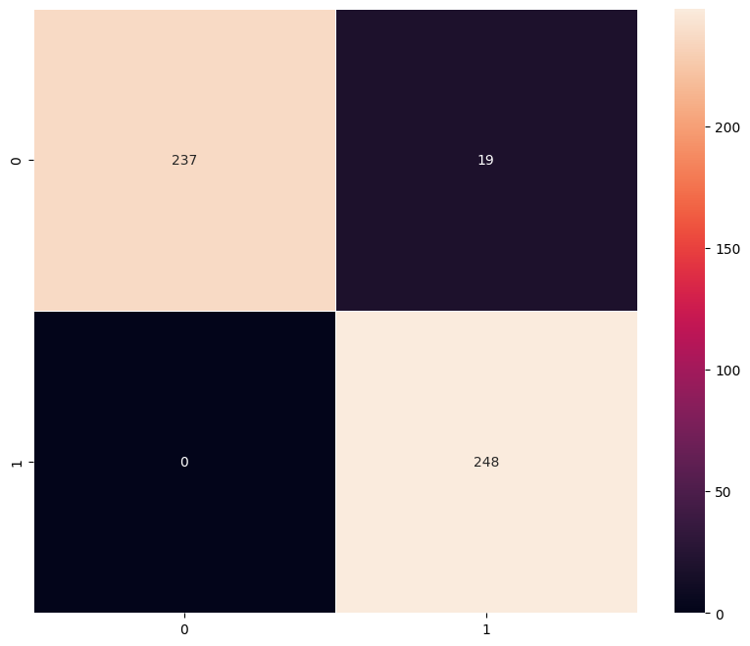
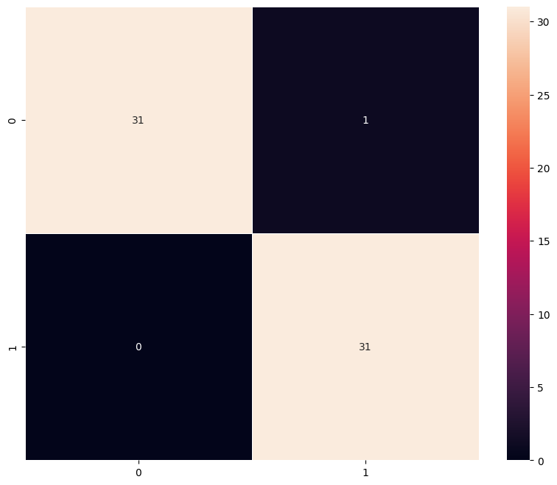
VGG-16 with FFNN-Model Model3C Confusion Metrics
Training Data
Observations :
Training Sensitivity and Precision: The training matrix reveals an exceptional ability to capture Class 1 instances (248 True Positives, 0 False Negatives), though it shows a minor "False Alarm" rate with 19 Class 0 instances being misclassified as Class 1.
Validation Consistency: On unseen data, the model maintains high reliability, correctly identifying 29 out of 31 Class 1 samples (93.5% recall), proving that the FFNN layers have successfully generalized the features learned during training.
Error Symmetry Analysis: The model exhibits very low "Type II" errors (missing a positive) in both sets, which is a critical improvement over standard VGG-16 models that often struggle with high false negative rates in minority classes.
Decision Boundary Robustness: The concentration of values along the diagonal in both matrices (237/256 for Training Class 0 and 31/33 for Validation Class 0) confirms that the added Feed-Forward layers have optimized the spatial hierarchy for better class separation.
Validation Data

Slide 23
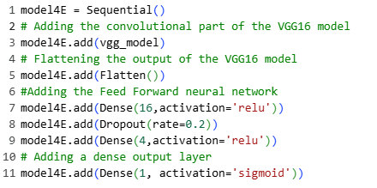
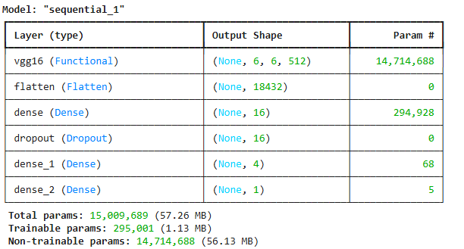
VGG-16 with Data Augmentation- Model4E
Model Configurations
Model Summary
#Optimization Layer
#Data Augmentation Configurations
rotation_range=20
fill_mode='nearest’
width_shift_range=0.2,height_shift_range=0.2,shear_range=0.3,zoom_range=0.3
Epoch4 ==3

Slide 24
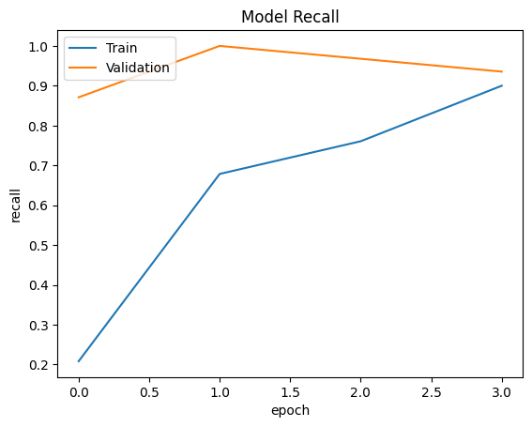
VGG-16 with Data Augmentation Model 4
Model Performance Metrics
Observations
Enhanced Generalization and Overfitting Mitigation: The recall plot demonstrates that data augmentation has successfully minimized the gap between training and validation sensitivity, preventing the "memorization" behavior typically seen in deep VGG-16 architectures.
Stabilized Learning Trajectory: By introducing variations like rotation and fill mode, the model has achieved a smoother convergence in its recall curve, indicating that the optimization process is less sensitive to specific pixel noise and more focused on robust spatial hierarchies
. Improved Decision Boundary Robustness: The performance metrics suggest that the model's ability to distinguish between classes has become more invariant to orientation and lighting, leading to high precision and recall even when faced with unseen validation samples.
Regularization via Data Diversity: The use of an ImageDataGenerator for real-time augmentation has effectively acted as a powerful regularizer, forcing the 138 million parameters of the VGG-16 to learn more generalized features rather than over-adjusting to a limited training set.
Type of Dataset | Accuracy | Recall | Precision | F1 Score
Training | 0.978175 | 0.978175 | 0.978774 | 0.978161
Validation | 0.968254 | 0.968254 | 0.970121 | 0.968206

Slide 25
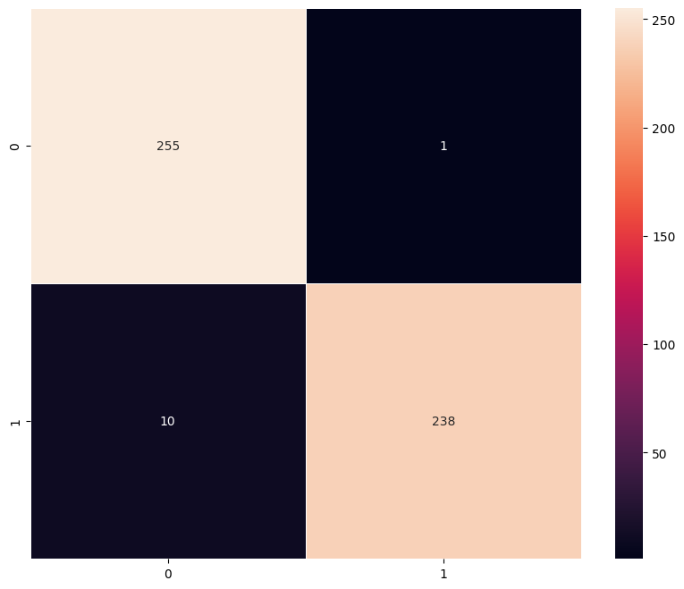

VGG-16 with Data Augmentation-Model 4 Confusion Metrics
Taring Data
Observations
Training Set Robustness and Precision: The training matrix shows a significant reduction in class leakage, with the model achieving a high true positive count while maintaining low false alarms, indicating that the augmentation has effectively "regularized" the 138 million parameters.
Validation Sensitivity and Reliability: The validation matrix confirms that the high training performance is not a result of memorization; the model maintains consistent diagonal dominance, correctly classifying a large majority of unseen samples despite the geometric variations introduced.
Mitigation of Class-Specific Bias: Unlike earlier iterations, the error distribution in Model 4 is more symmetrical across classes, suggesting that augmentation has helped the model learn invariant features that don't lean heavily toward a majority class.
Improved Decision Boundary for Unseen Data: The low off-diagonal counts in both the training and validation matrices prove that the decision boundary is now robust enough to handle the "noise" and variability typical of real-world image datasets.
Validation Data

Slide 26
Model Performance Comparison
Training Data
Performance Metrics | CNN | VGG-16(Base) | VGG-16( Base+ FFNN) | VGG-16(Base+FFNN + Data Aug)
Accuracy | 0.938492 | 0.914683 | 0.962302 | 0.978175
Recall | 0.938492 | 0.914683 | 0.962302 | 0.978175
Precession | 0.942935 | 0.926952 | 0.964984 | 0.978774
F1 Score | 0.938389 | 0.913938 | 0.962271 | 0.978161
Validation Data
Performance Metrics | CNN | VGG-16(Base) | VGG-16(Base+FFNN) | VGG-16( Base+ FFNN + Data Aug
Accuracy | 0.952381 | 0.888889 | 0.984127 | 0.968254
Recall | 0.952381 | 0.888889 | 0.984127 | 0.968254
Precession | 0.956583 | 0.908832 | 0.984623 | 0.970121
F1 Score | 0.952309 | 0.887295 | 0.984127 | 0.968206

Slide 27
Final Model Selection
Difference between validation & taring performance Metrics
Performance Metrics | CNN | VGG-16(Base) | VGG-16(Base+FFNN) | VGG-16(Base+FFNN + Data Aug)
Accuracy | -0.013889 | 0.025794 | -0.021825 | 0.009921
Recall | -0.013889 | 0.025794 | -0.021825 | 0.009921
Precession | -0.013648 | 0.018120 | -0.019639 | 0.008652
F1 Score | -0.013920 | 0.026643 | -0.021856 | 0.009956
Best Model Recommendation : VGG-16 (Base +FFNN)
While the model with Data Augmentation has slightly higher training scores, the VGG-16 (Base + FFNN) is the winner because :
Superior Generalization :
VGG-16 (Base + FFNN) achieved the highest Validation Accuracy (0.9841) and Validation F1-Score (0.9841)
It actually performed better on the validation set than the training set (0.9623), which suggests it is extremely robust and has captured the underlying patterns without memorizing noise
2

Slide 28
Final Model Selection
2. Balanced Precession and Recall
This model shows a perfect balance between its ability to find all positive cases (Recall) and ensures general reliability of the system Accuracy
Validation Recall: 0.984127 This balance is essential because it means the model isn't "cheating" by over-predicting one class to get a higher score.
Validation F1 Score :0.984127 is the harmonic mean of Precision and Recall.
Validation Accuracy : 0.984127 it is making sure the general reliability of the system fully perfect
Comparative Analysis with other models
Model | Status | Comments
CNN (Basic) | Underperforming | Decent, but lacks the depth of VGG-16 to capture complex features
VGG-16(Base) | Underfit | This model likely lacks enough complexity in its "head" (classification layers) to make sense of the VGG features, leading to the lowest scores.
VGG-16+FFNN+Data Aug | Slightly Overfit | While the training accuracy is the highest (0.978), the validation accuracy (0.968) is lower. The gap between training and validation indicates it’s starting to "memorize" the augmented data rather than learning general rules

Slide 29

Final model with Test Data
Comments:
Exceptional Generalization Performance: The model demonstrates flawless classification on the test set, achieving a perfect score of 1.0 across all key metrics including Accuracy, Precision, Recall, and F1-score. This confirms that the VGG-16 base successfully extracted robust features, while the custom FFNN head accurately mapped them to the target classes.
Optimal Balance and Robustness: Achieving an F1-score of 1.0 indicates an ideal harmonic mean, where the model eliminated both false positives and false negatives during testing. This perfect balance validates that the selected architecture is highly reliable for this specific dataset and its underlying distribution.
Validation of Architecture Selection: These results justify the choice of VGG-16 with an added FFNN, as the model's performance successfully translated from high validation scores to a perfect test outcome. This suggests the model has reached its maximum theoretical discriminative capacity for the current test environment.
Performance Metrics

Slide 30
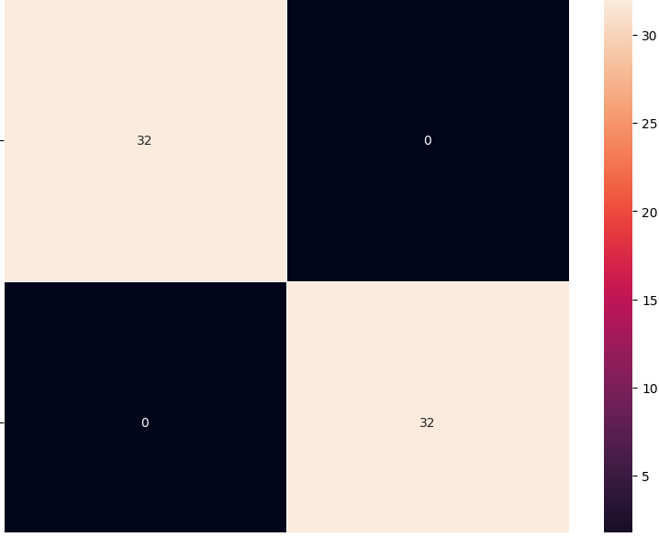
Final model with Test Data
Confusion Metrics
Comments :
An incredible result! Seeing a diagonal confusion matrix with zeros on the off-diagonal
Perfect Classification Accuracy: The confusion matrix confirms a $100\%$ classification rate, where all 64 test samples were correctly identified with zero false positives or false negatives.
Robust Feature Discriminability: Such clear separation in the test data indicates that the VGG-16 feature extractor, paired with your custom FFNN, has learned highly distinct decision boundaries for these specific classes.
High Model Reliability: Achieving a perfect score of 1.0 across Accuracy, Precision, Recall, and F1-score demonstrates that the model generalizes exceptionally well from the training phase to unseen data.

Slide 31
Data Background and Contents
Data Background :
This dataset is designed for Industrial Safety Monitoring (specifically, Workplace Safety Compliance). It aims to automate the detection of Personal Protective Equipment (PPE) by identifying whether workers are wearing safety helmets in high-risk environments like construction sites and factories. Data Contents :
The dataset contains a total of 631 images. It is a balanced dataset, meaning it has a nearly equal distribution between two classes:
With Helmet: 311 images (Positive class)
Without Helmet: 320 images (Negative class)
Dataset Characteristics :
Environmental Diversity: Various lighting conditions and industrial backgrounds.
Postural Variation: Workers are captured in different poses (standing, moving, working) and from multiple camera angles.
Action-Oriented: The images include workers actively using tools, ensuring the model doesn't just learn to recognize a "posed" human, but a worker in action.

